Slide 1
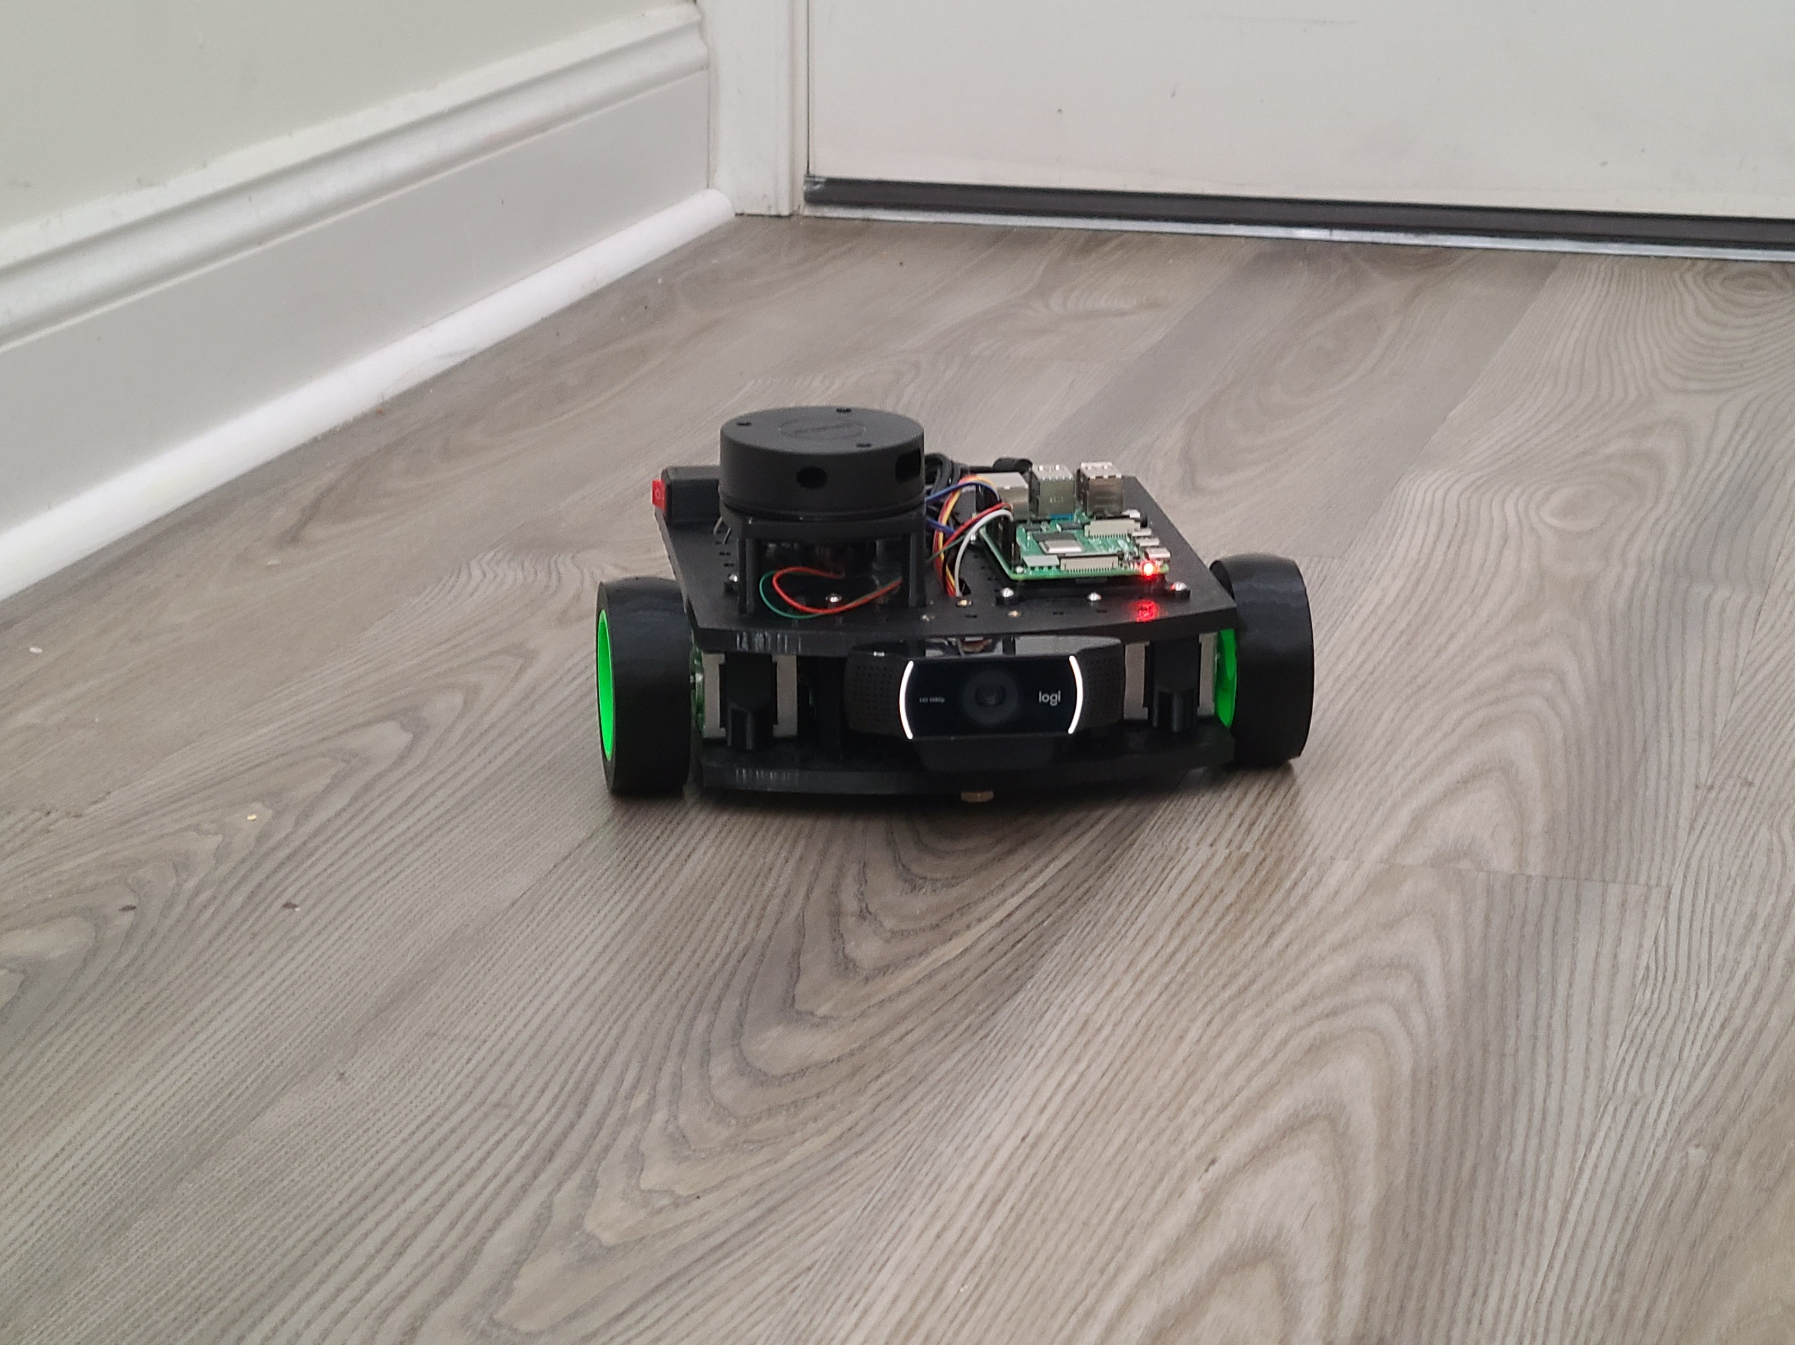
Voice-demanded robot with autonomous navigation
Japheth Beiler
Tyler Lindsay
Gabriel Marx
Instructor
Dr. Sayed Reza
Technical Advisor
Dr. Truong Tran
Notes:
(Gabriel) Introduction
Briefly introduce project
Introduce group members and roles (Tyler: hardware/LiDAR detection/decision making, ; Gabriel: object recognition/audio handling and transcription; JJ: decision making/testing)
Mention advisors

Slide 2
Purpose
This project is a demonstration of using machine learning and onboard sensors to navigate to objects safely while avoiding obstacles. With further development, we could specialize the application of the robot (e.g. rescue robot for situations dangerous for humans).
Notes:
(Gabriel) Purpose of our project
First goal: create a robot that could be controlled by voice commands
Second goal: enable autonomous navigation so that the robot could detect obstacles on its own and navigate around them
Create a software platform that can be extended by others for specific applications
Example: creating a “rescue robot” that can operate in environments that are dangerous for humans

Slide 3
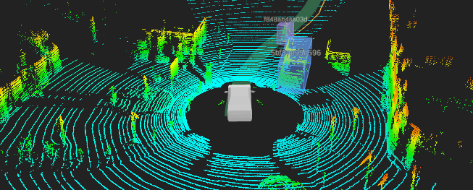
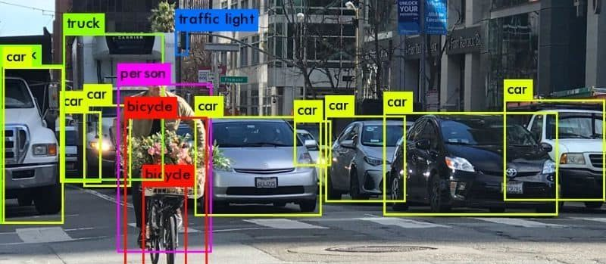
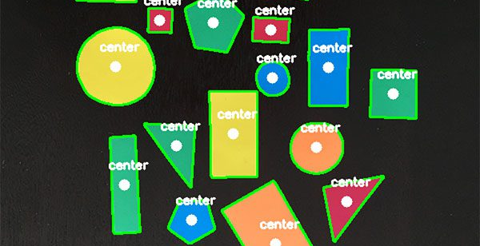
features
Interprets user speech as voice commands for movement
Uses computer vision to determine the position of targets (contour detection, centroid)
Processes LiDAR sensor data to determine distance and stop before collision
Uses LiDAR data to sense objects and move around them while searching for target
Azure machine learning object recognition
Provides web interface for displaying computer vision output and for manually controlling the robot
Notes:
(Gabriel) Robot features
Interprets voice commands and moves accordingly
Can scan its environment and use computer vision to locate targets and find their center
Uses a LiDAR sensor to detect obstacles
Offers object recognition capabilities through Microsoft Azure
Website with manual controls and computer vision output

Slide 4
Design considerations
Webcam: video & microphone quality, drivers for Linux
Raspberry Pi: processing power, networking
Battery pack: output requirements
Motors: movement accuracy
Cloud server: processing power, networking delay
Python libraries
Multithreading and concurrent programming
Internet protocol (IP): TCP & UDP
Computer vision: optimizations
Notes:
(Tyler) Design Considerations
Robot: webcam quality, Raspberry Pi processing power, battery pack output, motor movement accuracy
Sever processing power, networking delay, TCP and UDP
Python libraries
Necessity of multithreading due to real-time programming
Optimizing computer vision

Slide 5
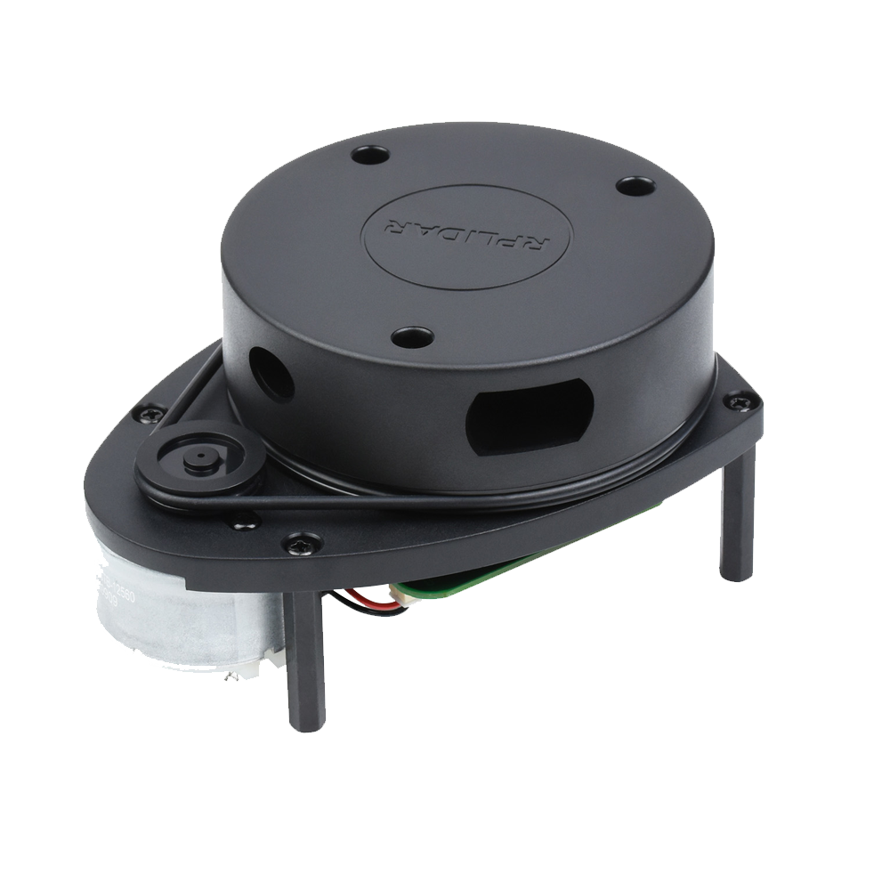
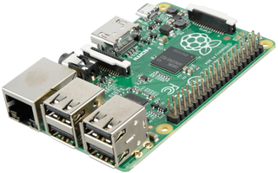
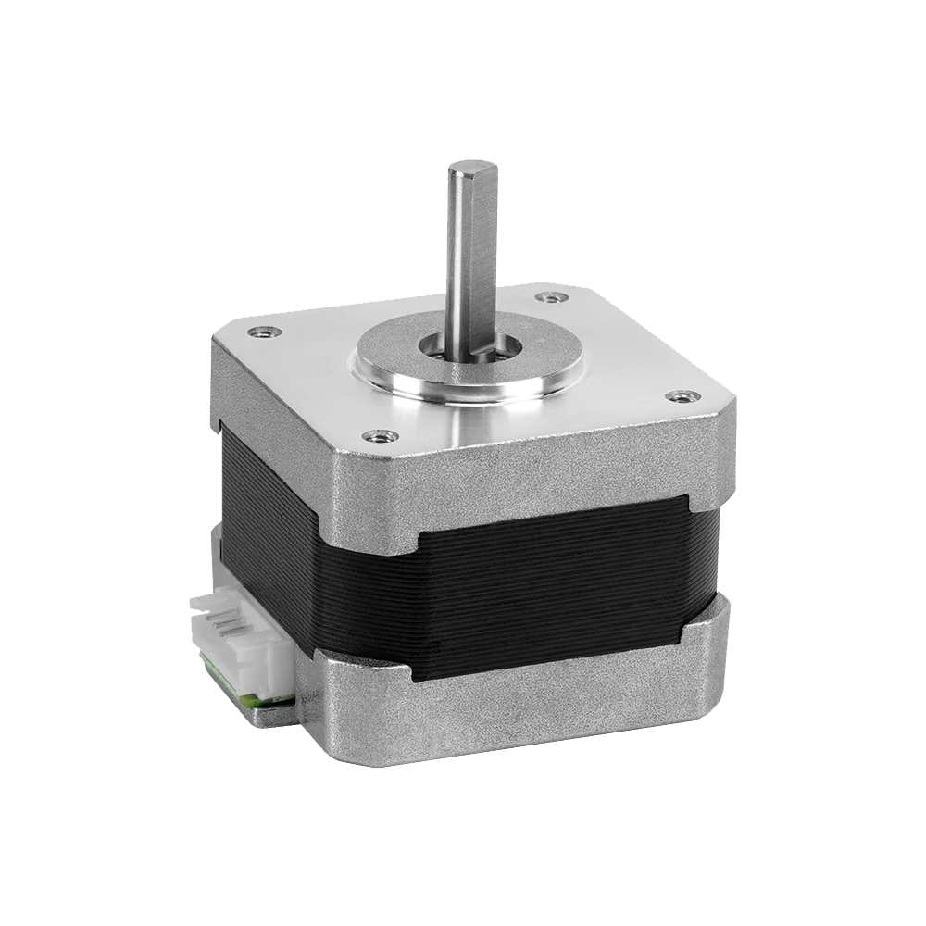
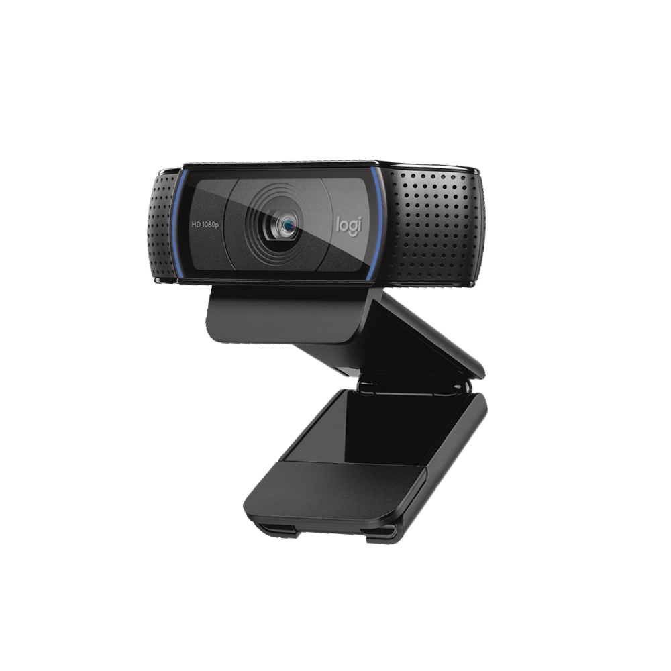
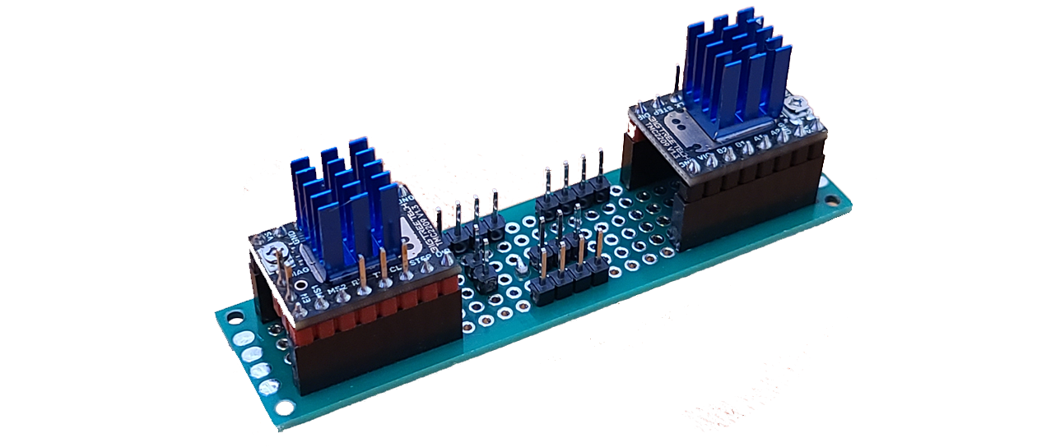
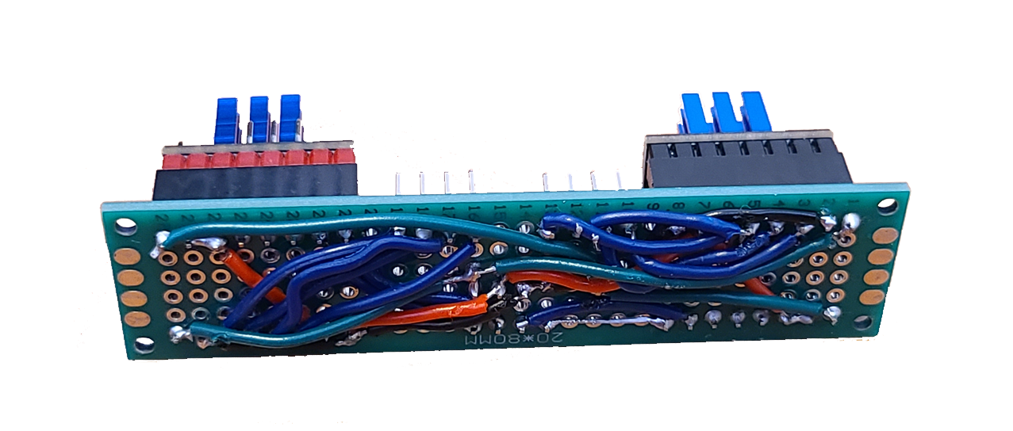
The Hardware
Raspberry Pi 4
LiDAR Scanner
Stepper Motors
Logitech Webcam
Hand-Soldered Circuit Boards
Fully 3D-Printed Construction
Notes:
(Tyler) Hardware components
The wiring between components
How time and money was wasted on motors which did not work well enough
Lead into 3d models

Slide 6
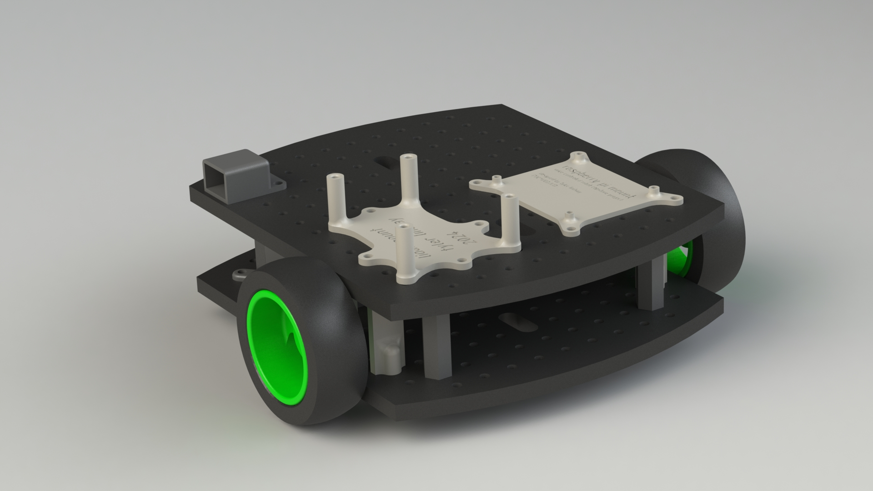
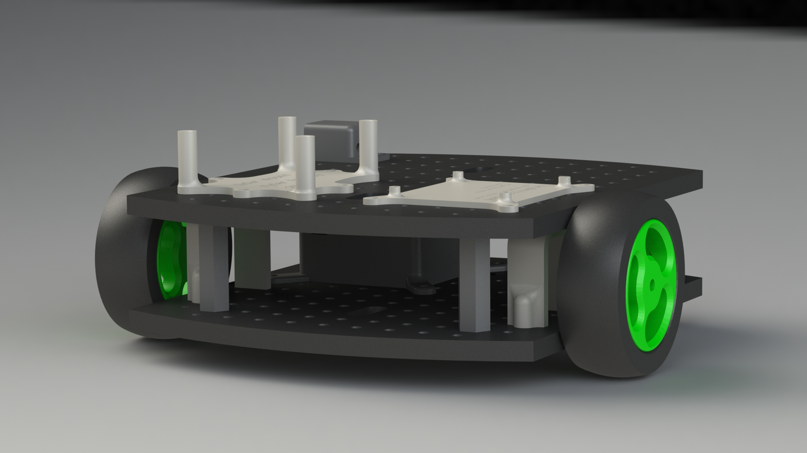
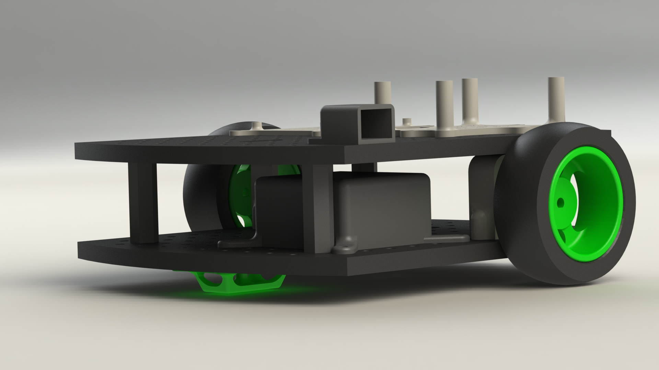
3d models
Notes:
(Tyler) Robot’s 3D models
Model design
Models were 3D printed

Slide 7









The software
TCP & UDP internet protocol
DigitalOcean: Server hosting
Flask: Web interface
Azure: Object recognition
OpenCV: Computer vision
OpenAI Whisper: Voice transcription
Real-time programming
Multithreading
Notes:
(JJ) Software
Couldn’t host everything on robot’s Raspberry Pi, so used a Droplet from DigitalOcean to host a Ubuntu server
Used the web framework Flask to create a web interface for manual controls and computer vision output
Used OpenCV (computer vision library) to detect targets
Used OpenAI Whisper for speech recognition and transcription
Had to implement real-time programming and multithreading to handle multiple concurrent processes

Slide 8




Implementation
WebSockets
DigitalOcean server
API calls
TCP/UDP
Flask website
OpenAI Whisper API
Robot
Notes:
(Tyler) Hardware components
The wiring between components
How time and money was wasted on motors which did not work well enough
Lead into 3d models

Slide 9
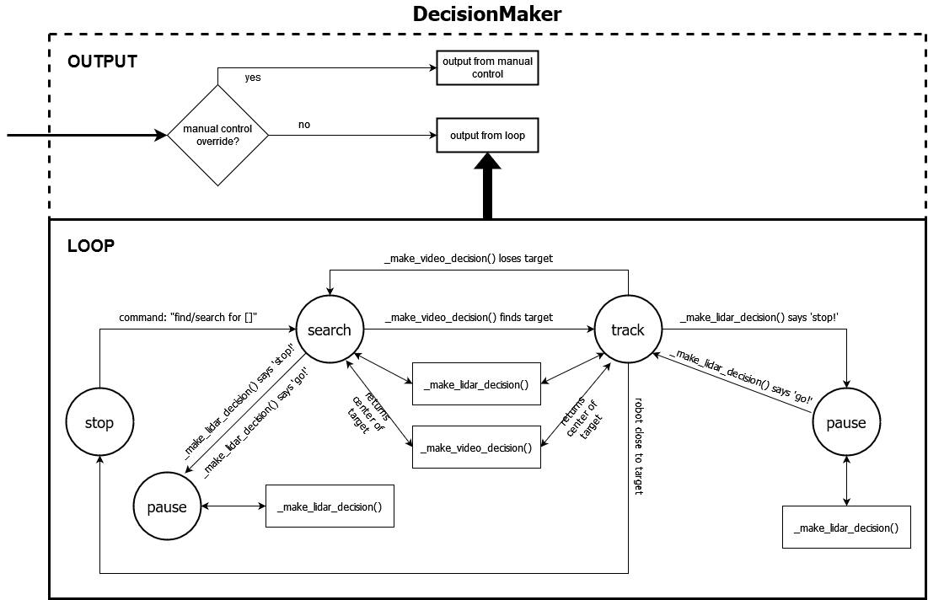

Slide 10
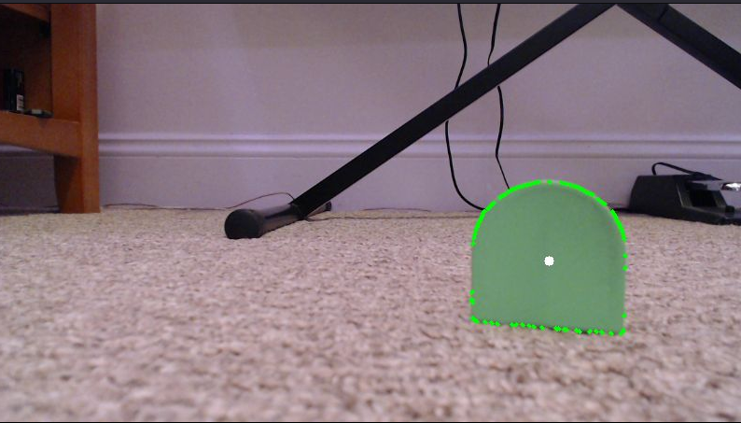
Unit testing
Example of testing function
DecisionMaker::_make_video_decision()
Input: <image>
Output: [723, 188]
Testing DecisionMaker class required unique methods
- MagicMock for mocking LiDAR and video input
- Multithreading considerations
with Python’s unittest library
Notes:
(JJ) Testing
Created unit tests using Python’s unittest library
Focused testing on our DecisionMaker class since it controls the robot’s decision making
Didn’t have the physical robot, so used Python’s MagicMock class to mock lidar and video input
Ran the unit tests and robot’s decision making on different threads to allow termination of the decision making but not the unit tests

Slide 11
Challenges
Video delay
Control accuracy
Collaboration
Audio Processing
Notes:
(Gabriel, Tyler, JJ) Challenges
Didn’t complete overcome video delay issue, worked with it by reducing the functional movement speed which required processing the video data, and implementing the functionality to not depend on small delay in the video data. Ex: Using lidar (which has a much lower delay) to stop the robot & not moving forward/backward when turning to face target.
Using stepper motors for movement made control more accurate – contrast with original motors.
Collaborating was difficult since our project is partially hardware-based. We overcame by using abstract classes, developing a testing environment where we can emulate the robot data in the client and run both the client and server locally.

